Slide 1
The Biggest Lie –
“No one ever dies from marijuana use”

Slide 2

Joel Cauchi 'satanic control' claim not taken seriously by psychiatrist, Bondi Junction inquest told
Each doctor agreed Cauchi was experiencing psychosis when he went on a stabbing rampage, killing six people and injuring 10 others before being shot dead by NSW Police Inspector Amy Scott. (April 13, 2024)
The court heard Cauchi was first admitted to the psychiatric ward of Toowoomba Public Hospital at the age of 17 after he was damaging doors and expressing concerns about being "possessed by demons".
The panel agreed Cauchi's previous cannabis use likely contributed to his early onset of schizophrenia and "certainly made his symptoms worse".
Professor Large told the inquest that cannabis "is the most potent and proven cause of schizophrenia".'
https://www.abc.net.au/news/2025-05-22/five-psychiatrists-evidence-dispute-dr-a-bondi-junction-inquest/105324318

Slide 3
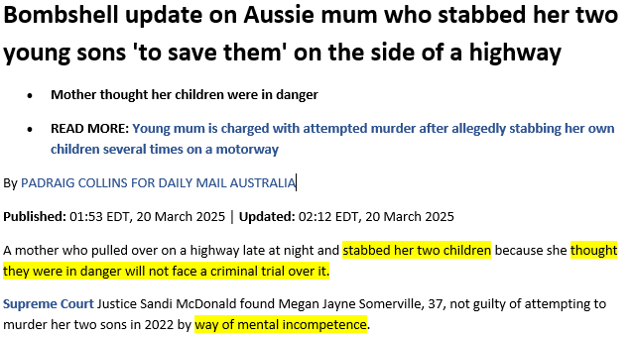
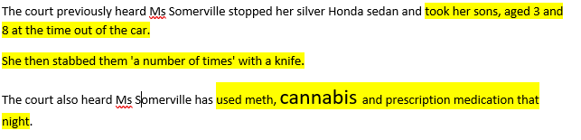
https://www.dailymail.co.uk/news/article-14518033/megan-somerville-adelaide-stab-sons.html

Slide 4
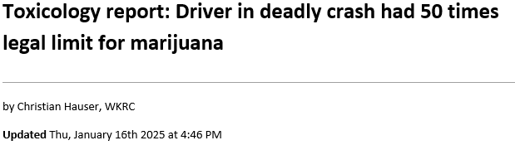
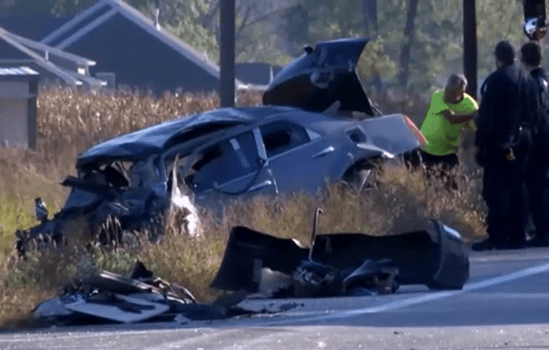
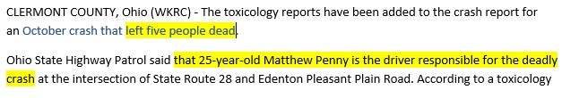
https://local12.com/news/local/toxicology-report-deadly-crash-driver-had-50-times-legal-limit-marijuana-pot-cannabis-weed-thc-intoxicated-goshen-township-clermont-county-fatal-illegal-blood-alcohol-level-drunk-oncoming-lane-traffic-wreck-gofundme-fundraiser-cincinnati-ohio

Slide 5
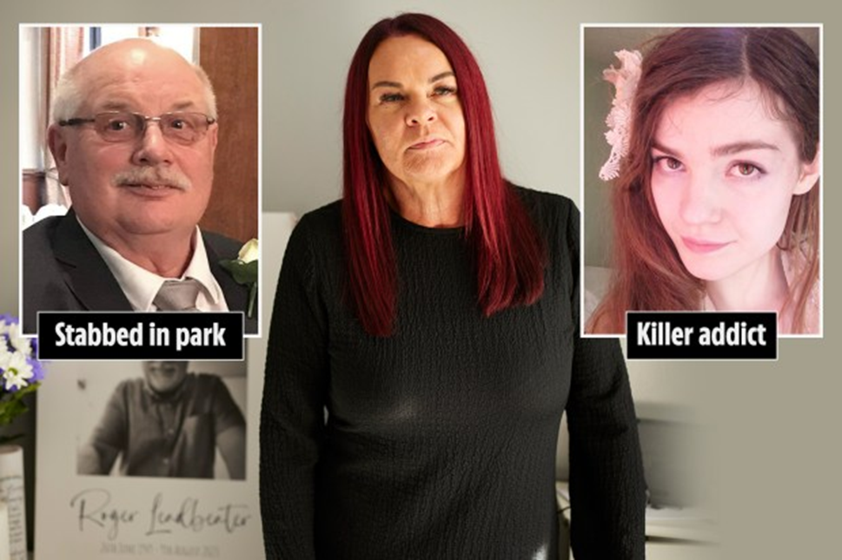
‘WORSE THAN HEROIN’
My kind uncle was murdered by cannabis-crazed mum… as experts warn Class B drug is fuelling wave of psychotic killers
Amid calls for weed to be decriminalised, psychiatrists warn the mind-altering element in cannabis is now almost seven times stronger than it was 35 years ago
It later emerged the woman charged with killing him, then 32-year-old schizophrenic Emma Borowy, was a habitual cannabis user who, when not being treated in a mental health hospital, would sacrifice feeding herself to pay for the drug.
Mother-of-one Borowy, who died in a suspected suicide in prison in December 2023, had absconded from Royal Bolton Hospital eight times since she was sectioned in October 2022, and each time she escaped she would buy weed and display increasingly concerning psychotic behaviour.
https://www.thesun.co.uk/health/35999706/uncle-murdered-cannabis-killers/

Slide 6
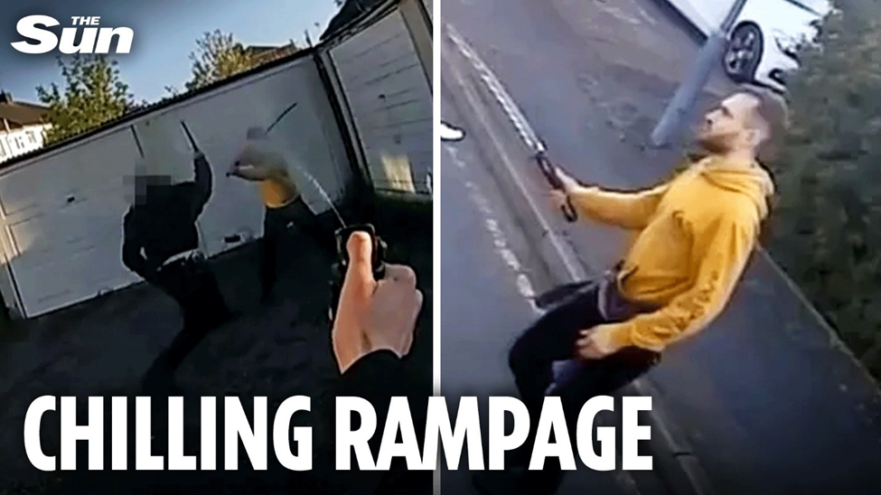
Mr Sidwick’s concerns are echoed by the findings of a Sun probe which reveals cannabis is behind a mental health epidemic that has seen a third of people presenting with psychosis in London developing it from heavy use of high strength weed.
The THC levels - the mind-altering element in weed - nowadays is almost seven times stronger than it was 35 years ago, shooting up from three per cent to 15-20 per cent in potent modern-day cultivated cannabis.
“Half of those people with cannabis induced psychosis will develop schizophrenia in five years.
“But it is not schizophrenia that makes you violent, it’s cannabis that makes you violent.
“Cannabis makes you paranoid, so if you’re hearing voices from God commanding you to do something, then you’re seeing violence in a bizarre and horrifying murder that is not like plotting to kill your wife in six weeks time, but a sudden psychotic episode where you kill whoever you come across.”
The effects of this were seen on June 27, when Marcus Arduini-Monzo, 37, was jailed for life after he murdered 14-year-old Daniel Anjorin with a samurai sword as he walked to school in a 20-minute rampage in East London.

Slide 7
Jake Notman, 28, was jailed for eight years and eight months after admitting to killing his girlfriend, Lauren Bloomer, during a psychotic episode triggered by a cannabis brownie.
In November 2020, Notman stabbed Bloomer more than 30 times and ran her over outside their Tamworth home.
Bloomer, 25, had begun recording on her phone after seeking help online for Notman's bad reaction to the drug.
Pietro Addis, 19, was jailed for 15 years in May 2023 after fatally stabbing his grandmother, Sue Addis, at her home in Withdean, East Sussex, in January 2021.
Though he admitted the killing, a jury accepted his plea of diminished responsibility due to a psychotic episode, finding him guilty of manslaughter.
Addis, diagnosed with ADHD in 2018, had been living with his grandmother but tensions rose over his cannabis use.
At the time of the attack, Brighton restaurateur Sue was seeking professional help for him.
On the day of the incident, Addis called 999, and police discovered Sue in the bath with 17 stab wounds.

Slide 8
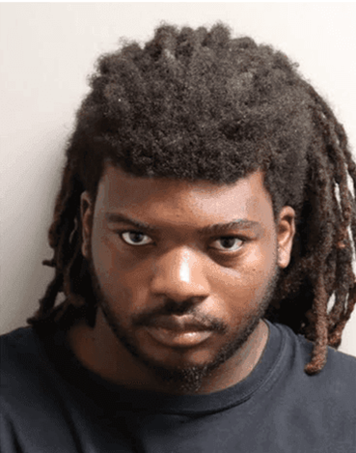
'When I smoke, I want to play': Man beat infant to death, claimed he was playing, police
TALLAHASSEE, Fla. (WKRC) - A man allegedly confessed to beating a 1-year-old to death, claiming that he was attempting to play with the child after smoking marijuana.
According to local outlet WCTV, police were dispatched to a residence at around 9:15 a.m. on Monday for a report of a 1-year-old baby who was not breathing. First responders were unable to save the child's life and pronounced her dead at the scene, the outlet reported.
The child was under the care of 25-year-old Deric Young at the time of the incident, according to an arrest affidavit obtained by people. Young was taken into custody and reportedly initially told police that he was uninvolved in the child's death.
Eventually, Young allegedly confessed to punching the infant multiple times in the face, even demonstrating the closed-fist attack to the interviewers. He claimed he hit the child on both sides of her face and head between two to three times, per the outlet.
Officers asked if Young lost his temper with the child and he reportedly declined, explaining that he was just playing with the young girl.
https://local12.com/news/nation-world/infant-baby-beat-death-playing-smoking-stoned-weed-marijuana-child-children-kid-kids-attack-attacked-assault-assaulted-police-head-face-play-mother-mom-man-adult-cannabis-multiple-times

Slide 9
Cannabis changed me, claims 'sword killer who hacked boy aged 14 to death after hallucinating that his cat was causing "Armageddon"', court hears
A cannabis user launched a samurai sword rampage hacking a 14-year-old boy to death after hallucinating that his cat was causing 'Armageddon', a court heard yesterday.
Marcus Monzo, 37, admitted that he had been using cannabis 'extensively' which had changed his personality and caused a mental health decline.
In the grip of a cannabis-induced 'psychotic disorder', the Brazilian is said to have strangled, skinned and deboned his cat, Wizard, before attempting to eat it.
https://www.dailymail.co.uk/news/article-14811521/Cannabis-changed-claims-sword-killer-hacked-boy-aged-14-death-hallucinating-cat-causing-Armageddon-court-hears.html

Slide 10
Man hit, killed by suspected DUI driver while on walk in southwest Las Vegas
LAS VEGAS, Nev. (FOX5) - Joree Odabi, 23, was killed while on a late afternoon walk in the southwest Las Vegas Valley. He was hit by a suspected impaired driver this week.
“You put stiffer laws and I don’t know, they’re they’re just not stiff enough and people, they just whatever, they’re going to go out and drink anyway,” Justice admitted.
“It’s very, very, very painful and really, I’m at a loss for words for losing my son,” his mother cried out.
Daniel Stakleff, 38, is facing deadly DUI and reckless driving charges. An arrest report reveals officers found an empty marijuana vape pen and cartridge in his car.
https://www.fox5vegas.com/2025/05/09/man-hit-killed-by-suspected-dui-driver-while-walk-southwest-las-vegas/

Slide 11
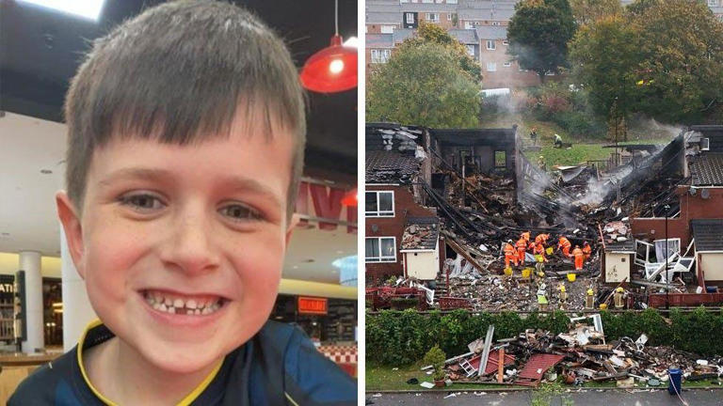
Cannabis factory blast killer's sentence reviewed
June 5, 2025
Archie York was sleeping in his living room when the explosion happened© Family handout / BBC
A man whose illegal cannabis factory exploded in a block of flats, killing a seven-year-old boy, is to have his 14-year jail sentence reviewed amid concerns it is too short.
Archie York died when the blast caused by Reece Galbraith, 33, destroyed several homes in Benwell, Newcastle, last October.
https://www.msn.com/en-us/news/world/cannabis-factory-blast-killer-s-sentence-reviewed/ar-AA1Gafbl?ocid=msedgntp&pc=HCTS&cvid=453b77f89f10460a9702a5ef748b2321&ei=21

Slide 12
The Biggest Lie –
“No one ever dies from marijuana use”

Slide 13
Father arraigned after 2-year-old son shoots, kills himself with unsecured gun
FLINT, MI – A Flint father has been arraigned on eight counts after his 2-year-old son fatally shot himself with an unsecured gun.
Omar Cortez Guy, 26, was arraigned Friday, May 17, by Genesee County District Court Magistrate Amy Clolinger on charges of violating Michigan’s safe storage law causing death, involuntary manslaughter, felon in possession of a firearm, lying to a peace officer, three counts of felony firearm and a single misdemeanor charge of possessing a firearm while under the influence.
According to a search warrant, there was a strong odor of marijuana throughout the house, and investigators determined the three men had been smoking marijuana
A bag of marijuana was also found in the bedroom where the gun – with a magazine of 15 live rounds – was located. One spent cartridge casing was still in the magazine well of the pistol. A single bullet hole was found in the ceiling above the bed.
https://www.mlive.com/news/flint/2024/05/father-arraigned-after-2-year-old-son-shoots-kills-himself-with-unsecured-gun.html

Slide 14

Riverdale actor, 24, who shot and killed his mother as she played piano says he carried out murder to spare her having to witness his plot to assassinate Justin Trudeau
Prosecutors said on Monday that Ryan Grantham, 24, fatally shot his 64-year-old mother, Barbara Waite, 'to save her' from seeing his assassination plot unfold
After shooting Waite in the back of her head as she played piano in 2020, Grantham covered her body with a sheet and placed rosaries and candles by her
According to the evaluations, Grantham exhibited cannabis use disorder, depression, self-hatred, and suicidal and homicidal tendencies months before the killing.
https://www.dailymail.co.uk/news/article-10922111/Riverdale-actor-killed-mother-spare-witnessing-plan-assassinate-Justin-Trudeau.html

Slide 15
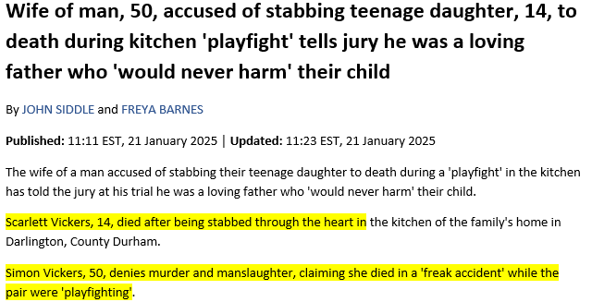
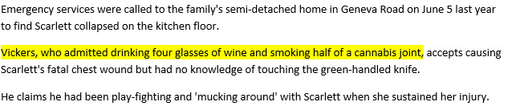
https://www.dailymail.co.uk/news/article-14309291/wife-man-accused-stabbing-teenage-daughter-death-tells-jury-loving-father-never-harm-child.html

Slide 16

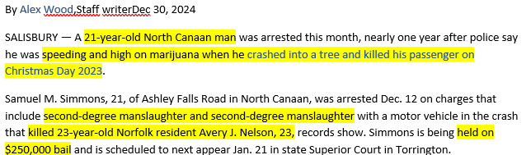
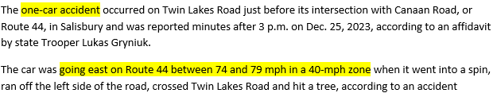

https://www.ctinsider.com/litchfield/article/salisbury-fatal-crash-samuel-simmons-avery-nelson-19979403.php

Slide 17
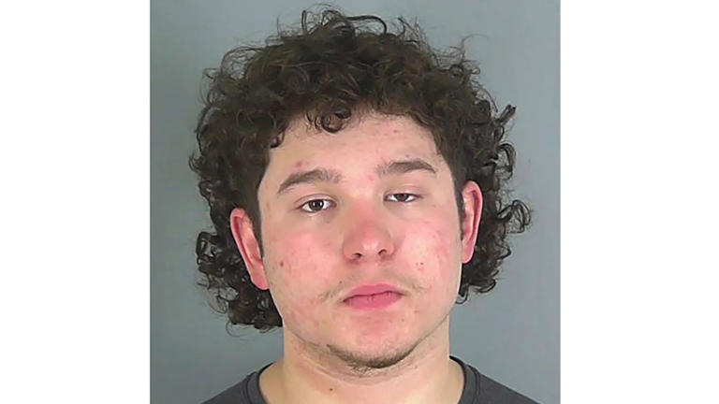



'American Idol' finalist Caleb Kennedy sentenced to 8 years in prison after deadly DUI crash
11/22/2024
https://www.msn.com/en-us/news/crime/american-idol-finalist-caleb-kennedy-sentenced-to-8-years-in-prison-after-deadly-dui-crash/ar-AA1uAPEu?ocid=msedgntp&pc=HCTS&cvid=7e2862df2c5e48e189374707a9b1a91c&ei=13#commentshttps://www.msn.com/en-us/news/crime/american-idol-finalist-caleb-kennedy-sentenced-to-8-years-in-prison-after-deadly-dui-crash/ar-AA1uAPEu?ocid=msedgntp&pc=HCTS&cvid=7e2862df2c5e48e189374707a9b1a91c&ei=13#comments

Slide 18
Murder accused psychotic for months, court told
Dylan Thomas has denied murder but pleaded guilty to manslaughter
A man who killed his best friend on Christmas Eve was experiencing psychosis "up to six months before the event", a court has heard.
Dylan Thomas, 24, has admitted the manslaughter of William Bush, 23, at a house they shared in Llandaff on 24 December 2023, but has denied murder.
A forensic psychiatrist treating Mr Thomas for schizophrenia at Ashworth High Secure Hospital told Cardiff Crown Court he believed he was psychotic for months before stabbing his best friend.
https://www.bbc.com/news/articles/c774m6n7xn1o

Slide 19
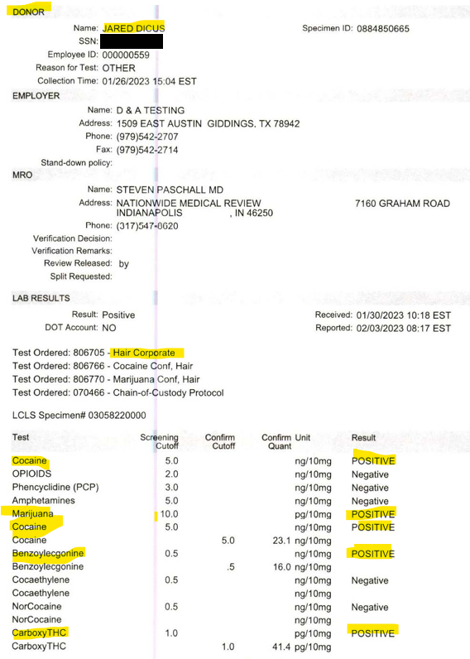
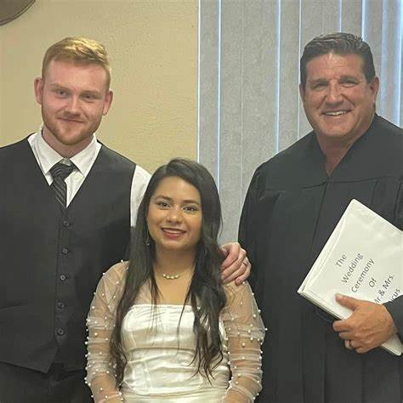
Man who decapitated newlywed wife sentenced to 40 years in Texas prison
A judge in Texas sentenced a man to four decades in prison for decapitating his newlywed bride last year.
District Court Judge Gary Chaney sentenced 23-year-old Jared James Dicus to 40 years behind bars after he pleaded guilty to brutally murdering his wife, Anggy Diaz, last year, The Waller County District Attorney's Office reported.
A motive in the killing was not released by police but prosecutors said during the pre-trial phase of the case, "potential mental health issues were raised regarding the Defendant’s competency to stand trial."
https://www.usatoday.com/story/news/nation/2024/08/06/jared-dicus-sentenced-decapitating-wife-anggy-diaz/74684360007/

Slide 20
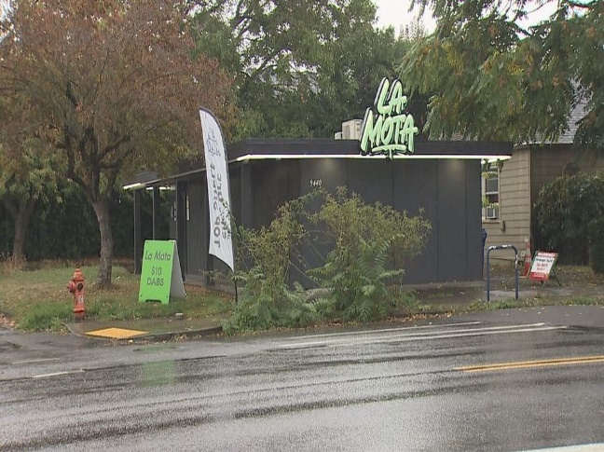
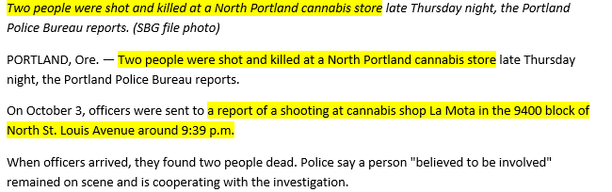
2 people shot dead at North Portland La Mota cannabis shop
https://katu.com/news/local/2-people-shot-dead-at-north-portland-cannabis-shop#

Slide 21
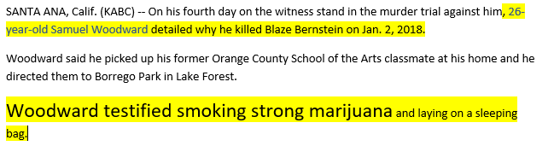
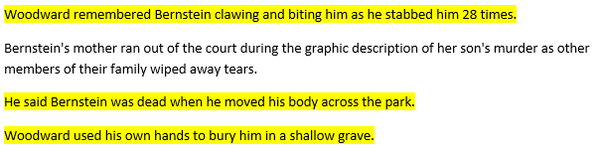
Samuel Woodward details why he killed Blaze Bernstein while testifying in his murder trial
ByDavid González
Thursday, June 20, 2024
https://abc7.com/post/blaze-bernstein-murder-samuel-woodward-details-he-killed/14982496/

Slide 22
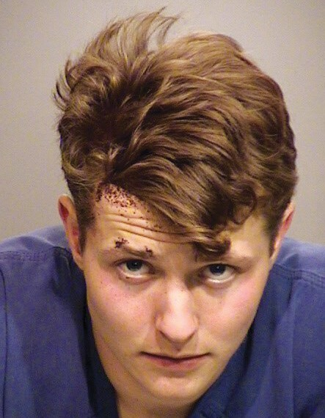
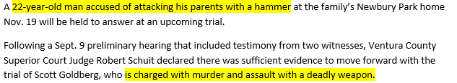

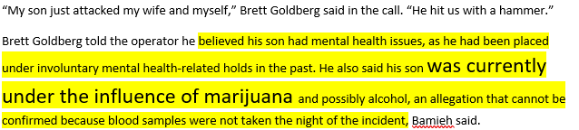
Goldberg to stand trial
September 20, 2024 By Makena Huey makena@theacorn.com
https://www.toacorn.com/articles/goldberg-to-stand-trial/

Slide 23

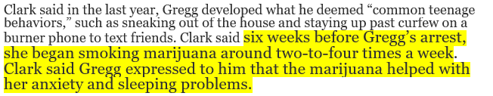

Please help me': Journal shows Carly Gregg battled with mental health. Defense rests case
https://www.clarionledger.com/story/news/2024/09/18/defense-carly-madison-gregg-expects-first-witness-in-murder-trial/75244116007/

Slide 24
The Biggest Lie –
“No one ever dies from marijuana use”

Slide 25
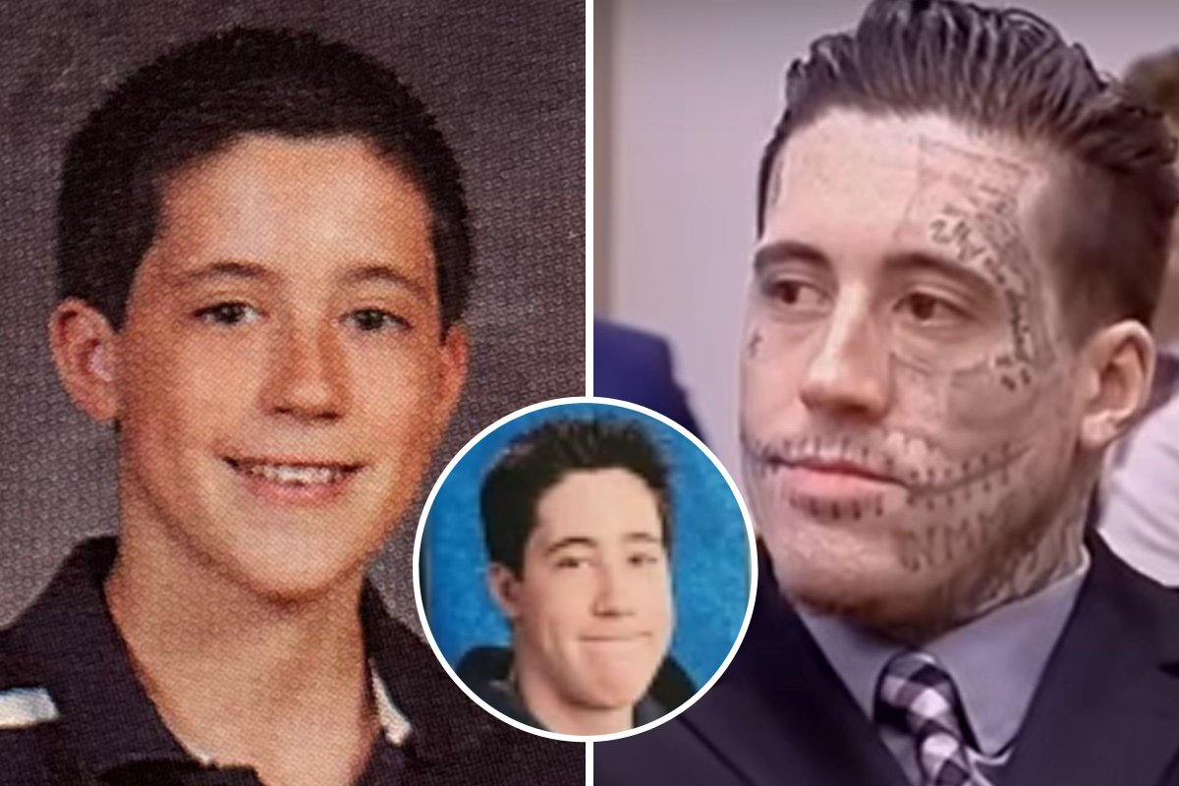
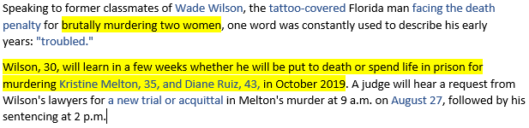
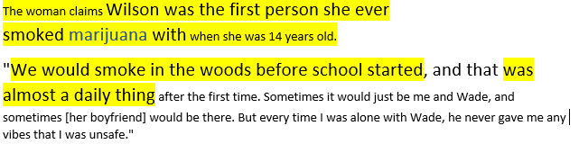
Wade Wilson's 'Troubled' Early Years: The Making of A Convicted Killer
Published Aug 08, 2024 at 9:44 AM EDTUpdated Aug 27, 2024 at 12:39 PM EDT
https://www.newsweek.com/wade-wilson-killer-crimes-florida-early-years-1935964

Slide 26
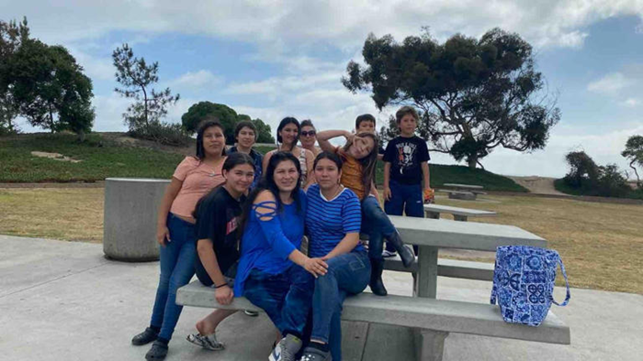
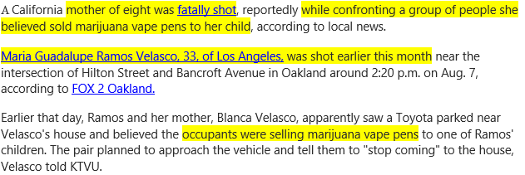
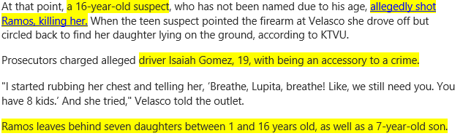
California mom of 8 fatally shot while protecting kids from drug dealers in harrowing footage
https://www.msn.com/en-us/news/crime/california-mom-of-8-fatally-shot-while-protecting-kids-from-drug-dealers-in-harrowing-footage/ar-AA1p3Py1?ocid=BingNewsSerp

Slide 27
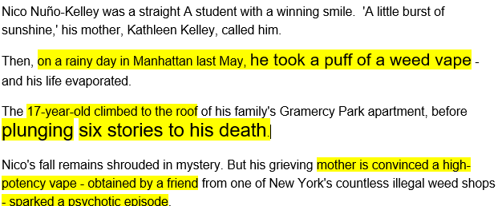
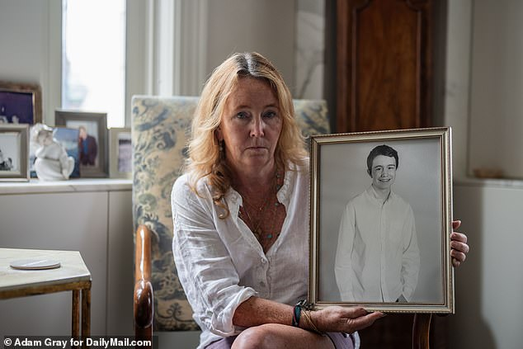


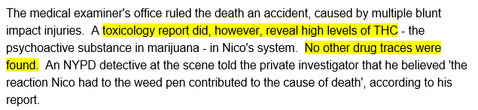
Distraught mother shares heartbreaking tragedy that unfolded after son, 17, took just 'a few puffs' of a weed vape
https://www.dailymail.co.uk/news/article-13672067/distraught-mother-tragedy-son-weed-vape.html

Slide 28
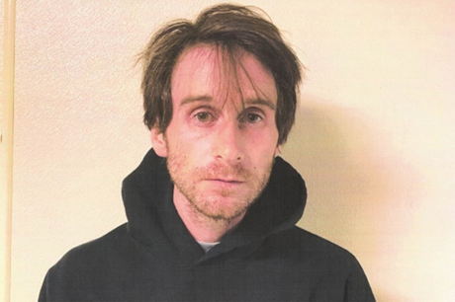

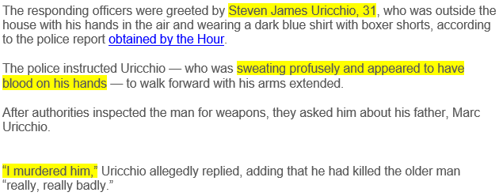
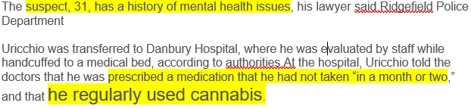
One of Connecticut’s safest towns has its first murder in 21 years, and it’s straight out of a horror movie
https://nypost.com/2024/08/07/us-news/man-allegedly-gutted-dad-in-ct-towns-first-murder-in-20-years/

Slide 29
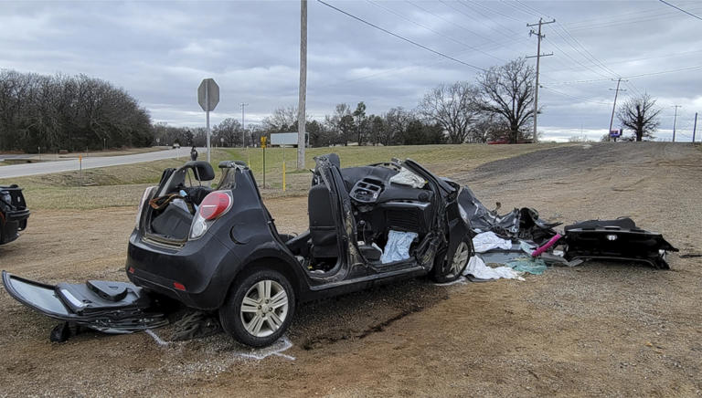
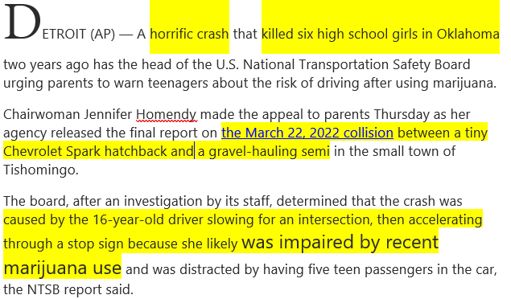

After crash that killed 6 teens, NTSB chief says people underestimate marijuana's impact on drivers
https://www.msn.com/en-us/health/health-news/after-crash-that-killed-6-teens-ntsb-chief-says-people-underestimate-marijuana-s-impact-on-drivers/ar-BB1qdBte?ocid=msedgntp&pc=DCTS&cvid=b602e404caab48558773e5246c9a3f73&ei=53

Slide 30
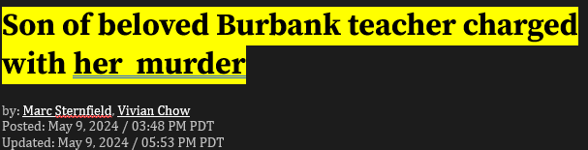
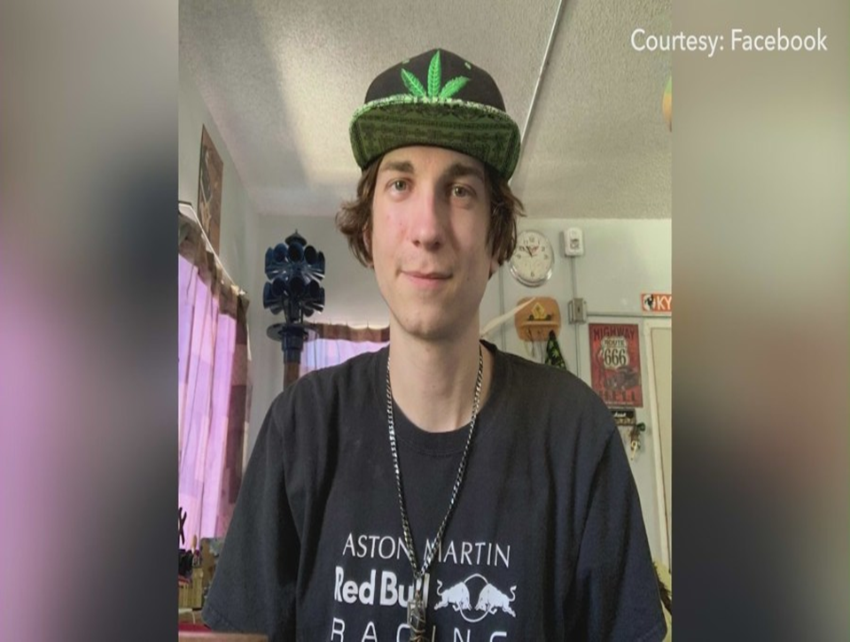
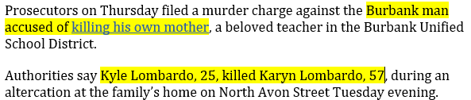
https://ktla.com/news/local-news/son-of-beloved-burbank-teacher-charged-with-her-murder/

Slide 31

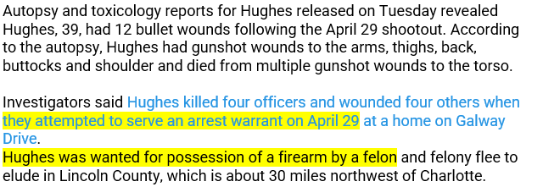
Man who killed 4 Charlotte officers was shot 12 times, had THC in his system, reports show
https://www.wral.com/story/man-who-killed-4-charlotte-officers-was-shot-12-times-had-thc-in-his-system-reports-show/21517166/

Slide 32


Senator's son pleads not guilty to charges from crash that killed North Dakota sheriff's deputy
https://www.msn.com/en-us/news/crime/senator-s-son-pleads-not-guilty-to-charges-from-crash-that-killed-north-dakota-sheriff-s-deputy/ar-BB1lNl9E?ocid=msedgntp&pc=HCTS&cvid=f8cab734c7ba4e6b94ecfd75b08b54e3&ei=13

Slide 33

Man Charged With Killing 4 in Stabbing Rampage Blames Drugs
https://www.nytimes.com/2024/03/27/us/rockford-illinois-stabbing.html

Slide 34
The Biggest Lie –
“No one ever dies from marijuana use”

Slide 35
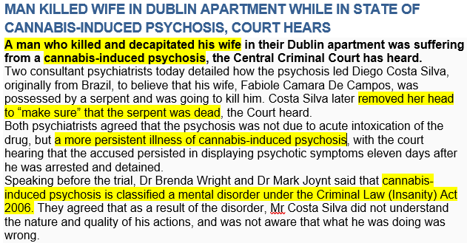
https://gript.ie/man-killed-wife-in-dublin-apartment-while-in-state-of-cannabis-induced-psychosis-court-hears/

Slide 36
Police: Man arrested for driving while impaired, fatally striking pedestrian in Coram
Feb 25, 2024, 9:15 AM
Suffolk police say a 25-year-old man was arrested Saturday after he fatally struck a man who had fallen out of his wheelchair while trying to cross a busy roadway in Coram.
Raymond Hubbard, 33, was lying in the roadway in front of 541 Middle Country Road Saturday after 10 p.m. when he was hit by a 2003 Chevy Suburban. Police say the driver, Centereach's Nicholas Doxtader, was impaired at the time of the incident.
Hubbard was pronounced dead at the scene, according to authorities.
Prosecutors told the court that Doxtader admitted to police at the scene that he had taken five hits of marijuana when he got behind the wheel. Doxtader was charged with driving while ability impaired by drugs.
Doxtader apologized to Hubbard's family.
https://longisland.news12.com/police-man-arrested-for-driving-while-impaired-fatally-striking-pedestrian-in-coram

Slide 37
Woman Allegedly Frames Twin Sister For Fatal Amish Buggy Crash
Minnesota prosecutors have charged Samantha Jo Petersen with 21 counts including criminal vehicular homicide and driving under the influence of drugs.
PRESTON, Minn. (AP) — A Minnesota woman is accused of trying to deceive authorities into believing her identical twin sister was the driver who hit a horse-drawn Amish buggy last fall, killing two of the four children inside.
Samantha Jo Petersen, 35, of Kellogg, was charged in Fillmore County District Court on Monday with 21 counts including criminal vehicular homicide and driving under the influence of drugs.
The Sept. 25 crash killed 7-year-old Wilma Miller and 11-year-old Irma Miller, while their 9-year-old brother and 13-year-old sister were seriously injured. They were riding to school at the time.
Petersen has a criminal history in Minnesota that includes two convictions for driving under the influence and one for giving a false name to police. Her twin has not been charged.
According to the criminal complaint, Petersen’s blood tested positive for methamphetamine, amphetamine and THC, the active ingredient in marijuana.
Deputies also found a couple of burnt marijuana blunts and a small tin can commonly used to hold marijuana.
https://www.huffpost.com/entry/ap-us-amish-buggy-deaths_n_65c29adfe4b069b665dd2257

Slide 38
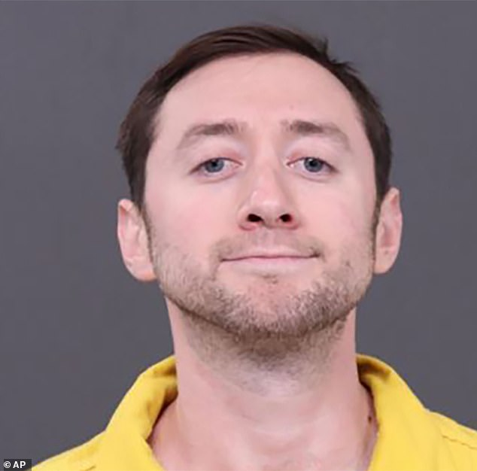
Neighbors of Justin Mohn, who beheaded his father, say he was 'acting strange' and smoking marijuana heavily before the gruesome murder
One woman described the Pennsylvania man as 'a fixture in the neighborhood'
Another neighbor claimed he called the police after Mohn stared at his house constantly
The 32-year-old was charged with first-degree murder in relation to the gruesome beheading death of his father, 68-year-old Michael Mohn
'Something was unhinged with him,' Carrie McCarthy told WPVI-TV. She said she clicked on the 14-minute video and screamed.
'He's a fixture in the neighborhood,' McCarthy continued. 'He would just walk around, always have his water bottle. And he would stop in random spots and just light up a joint and just start smoking.'
https://www.dailymail.co.uk/news/article-13033819/justin-mohn-beheading-youtube-neighbors-acting-strange-unhinged.html

Slide 39
5 arrested in California desert killings in dispute over marijuana, sheriff’s officials say Updated: 7:53 AM PST Jan 30, 2024
SAN BERNARDINO, Calif. —
The six men found dead at a remote dirt crossroads in the Southern California desert last week were likely shot to death in a dispute over marijuana, sheriff's officials said Monday as they announced the arrests of five men suspected in the violence.
Authorities discovered the bodies Tuesday in the Mojave Desert outside El Mirage after someone called 911 and said in Spanish that he had been shot, San Bernardino County Sheriff’s Sgt. Michael Warrick said during a news conference.
All the victims were likely shot to death, and four of the bodies had been partially burned together, Warrick said. A fifth victim was found inside a Chevy Trailblazer, and the sixth was discovered nearby the following day, he said.
“It looks like illicit marijuana was the driving force behind these murders,” Sheriff Shannon Dicus said, adding that the area is known for illegal marijuana growing
https://www.kcra.com/article/san-bernardino-6-dead-5-arrested-marijuana-dispute/46578304

Slide 40
Man who died in Delta jet engine at SLC Airport had a manic episode, family says
By Lindsay Aerts, KSL-TV and Aimee Cobabe, KSL NewsRadio | Posted - Jan. 3, 2024 at 9:07 p.m.
SALT LAKE CITY — The family of a man who died after crawling into a plane engine at the Salt Lake International Airport on Monday night said their son and brother was likely having a manic episode.
Judd Efinger said his son, Kyler Efinger, was diagnosed with bipolar disorder 10 years ago. He said it was triggered by severe bullying in high school.
"He's a soccer player and a skater, so I guess he ran a large distance on an open runway, you know, to this de-icing area. Unfortunately, took off his clothes," Judd Efinger said. "But it just speaks to the state. You know, he's just so manic at that point that he just didn't have any rational thoughts."
Judd Efinger said his son did have a medical marijuana card and used medical marijuana to self-medicate for his bipolar disorder. The family won't know if he had anything in his system until the toxicology report comes back.
https://www.ksl.com/article/50834340/man-who-sied-in-delta-jet-engine-at-slc-airport-had-a-manic-episode-family-says#:~:text=SALT%20LAKE%20CITY%20%E2%80%94%20The%20family%20of%20a,was%20triggered%20by%20severe%20bullying%20in%20high%20school.

Slide 41
Man charged in deadly Christmas Day crash
A Lancaster man is charged with driving under the influence and causing a crash that left a woman dead and a child injured.
Published: 2:56 PM EDT April 4, 2024
LANCASTER, Pa. — A Lancaster man has been charged with driving under the influence and causing a crash that left a woman dead and a child injured on Christmas Day 2023.
According to the criminal complaint, it was a three-vehicle head-on crash with entrapment. Police say that one of the vehicles caught fire.
Authorities said that Karina Cruz-Camuy, 27, was pronounced dead at the scene of the crash, and a child was transported to the hospital. Both were occupants of Maldonado's vehicle
Police said that Maldonado consented to a blood draw while at Penn Medicine - Lancaster General Health and doctors found that he had marijuana and fentanyl in his system within two hours of crashing the vehicle.
Officials were able to conduct crash reconstruction and determined that Maldonado was driving at least 50 MPH in a posted 35 MPH zone at the time of the crash.
https://www.fox43.com/article/news/crime/man-charged-deadly-christmas-2023-crash-lancaster/521-21c6864b-3338-4e02-b0df-fd2cdfd66673

Slide 42
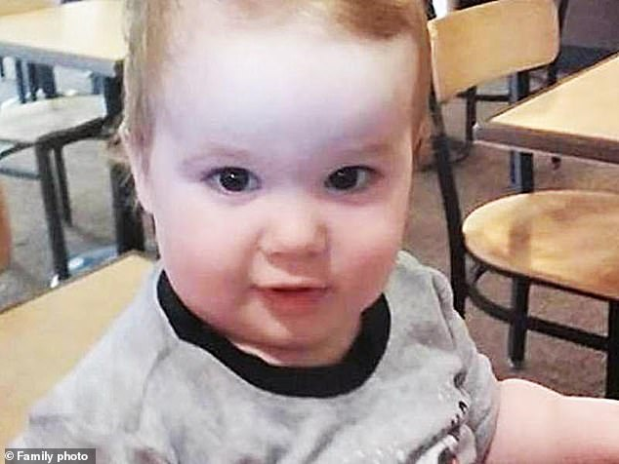
EXCLUSIVE: From 18 year-old who shot his girlfriend's baby while high on marijuana to stoned babysitter who let TWO toddlers drown: we reveal how cannabis has led to nearly 300 brutal child deaths
At least 290 American children have suffered brutal, preventable deaths linked to marijuana over the last decade, according to an analysis seen exclusively by DailyMail.com.
The highest proportion of deaths – 95 – involved extreme violence, the dossier of reports show.
This includes the case of a Texan man who murdered his girlfriend and nine-month baby with a pocket-knife while suffering what was believed to be a cannabis-induced psychotic episode.
Studies show that regular use of marijuana is linked to a five-fold increased risk of psychotic illness.
Also significant is the 2020 death of eight-month-old Josiah Guyton, who sustained fatal injuries after being ‘forcibly hit against a table and dresser’ by his mother’s boyfriend, Jermaine Abron.
https://www.dailymail.co.uk/health/article-12795775/marijuana-psychosis-child-death-cannabis-legalization.html

Slide 43
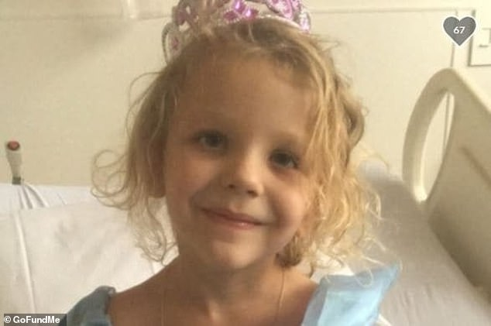
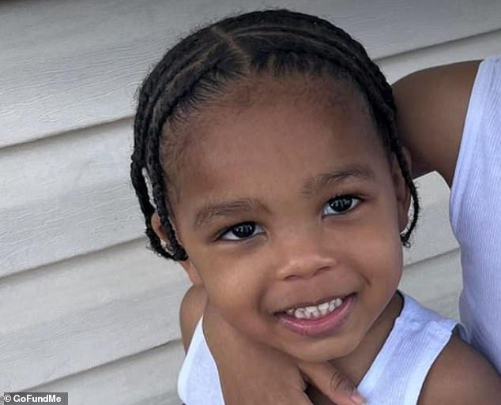
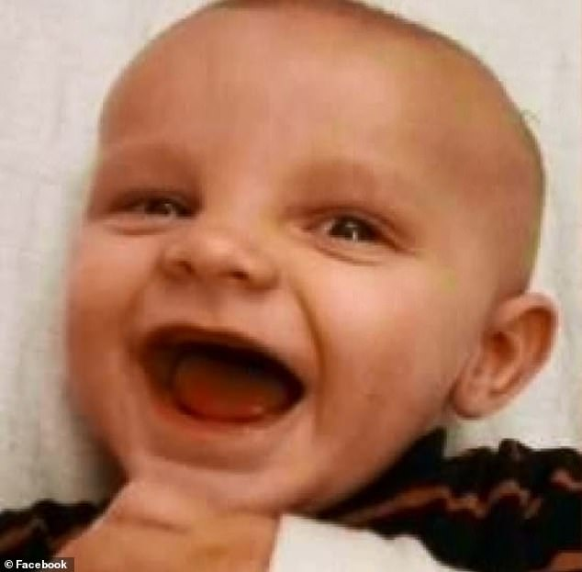

Emily Rose Perrin, who suffered cystic fibrosis, was
suffocated and killed by her mother who is believed to
have been experiencing psychiatric illness related to
cannabis use
Kiaire McCoy got hold of his mother's ex-boyfriend’s
loaded gun and shot himself earlier this year. The gun
owner was supposed to be watching Kiaire but 'zoned
out' while high on marijuana
18 year-old Henry Bartle smoked marijuana next to his
girlfriend's baby, Nathaniel Hitt, when his shotgun slipped
from his lap and went off, killing the infant
Earlier this month Bille Sue VanDyke, 25, from West
Virginia was charged with neglect after her child was
hospitalized with complications related with marijuana.
Her 3 year-old ate a gummy containing 350mg of THC, and
began vomiting and before reaching a 'comatose’ state

Slide 44

Police: Chicago Man Fatally Shoots Childhood Buddy, Then Steals His Marijuana Blunt
A 25-year-old Chicago man is accused in the fatal shooting and robbery of a longtime friend on November 7.
Authorities charged Quntin Buchanan with two counts of murder and one count of robbery for taking the victim’s marijuana blunt, CWB Chicago reported Tuesday.
According to CWB Chicago, not long after 20-year-old Jeremiah Pruckler and two of his childhood friends met up to smoke marijuana on 2900 South State, Buchanan joined the group.
A few hours later, law enforcement found Buchanan near the 95th Street Red Line station. While he ran from them he began stripping off his clothes.
Police eventually found him again wearing nothing but his boxers.
https://www.breitbart.com/crime/2023/11/14/police-chicago-man-fatally-shoots-childhood-buddy-steals-his-marijuana-blunt/

Slide 45
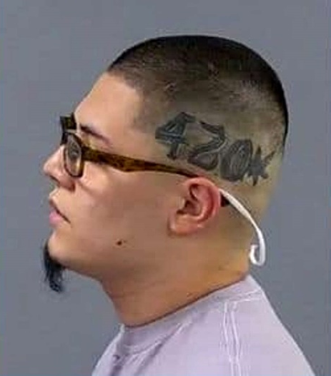
Man who allegedly beheaded relative and took her head wanted by Santa Rosa PD
The Santa Rosa Police Department is asking for assistance in locating a homicide suspect who allegedly decapitated a woman. Santa Rosa PD officers responded to a residence in the 2500 block of Pomo Trail on Thursday at 3:40 p.m. regarding a possible homicide.
The investigation revealed Luis Gustavo Aroyo-Lopez, a 24-year-old Santa Rosa resident who was related to the victim, killed her before leaving the scene, according to SRPD. Police believe Aroyo-Lopez took the woman’s head with him when he left the scene and may still be in possession of it.
He was a large tattoo of “420” and a marijuana leaf on the left side of his head, police said. Aroyo-Lopez is believed to have left the residence and walked south on Iroquois Street.
https://www.msn.com/en-us/news/crime/man-who-allegedly-beheaded-relative-and-took-her-head-wanted-by-santa-rosa-pd/ar-AA1jm1QS

Slide 46
The Biggest Lie –
“No one ever dies from marijuana use”

Slide 47
Suburban man was high on marijuana while striking, killing 81-year-old, prosecutors allege
by: Andy Koval
Posted: Oct 13, 2023 / 12:20 PM CDT
Updated: Oct 13, 2023 / 12:22 PM CDT
BUFFALO GROVE, Ill. — A suburban man was charged last week for allegedly striking and killing a 81-year-old man earlier this year while high on marijuana.
On the night of April 8, police responded to the area of Buffalo Grove Road and Golf View Terrace on the report of a crash involving a pedestrian
On Oct. 4, Naftaliev was charged with an aggravated DUI for allegedly being over the legal blood limit for cannabis. He turned himself in, police said.
https://wgntv.com/news/northwest-suburbs/suburban-man-was-high-on-marijuana-while-striking-killing-81-year-old-prosecutors-allege/

Slide 48
Report: Pilot in deadly balloon crash had drugs in system
Published 9:49 AM PDT, September 22, 2021
ALBUQUERQUE, N.M. (AP) — A report from the Federal Aviation Administration shows the pilot of a hot air balloon that crashed in New Mexico in June had marijuana and cocaine in his system.
Pilot Nicholas Meleski died along with his four passengers after the balloon descended in the sky above Albuquerque, hit power lines and crashed into a busy intersection.
https://apnews.com/article/new-mexico-albuquerque-marijuana-transportation-federal-aviation-administration-5f5d5cf583c4e673c73f65a5d32dcc14

Slide 49
Ohio teen murdered boyfriend, friend by deliberately crashing car at 100 mph: ‘Literal hell on wheels’
An Ohio teen is facing life in prison after being convicted of murdering her boyfriend and his friend by deliberately driving her car into a brick wall at 100 mph — with a judge calling her “literal hell on wheels.”
Mackenzie Shirilla, 19, sobbed in court as she was found guilty of four counts of murder for the July 2022 crash that killed her boyfriend, Dominic Russo, 20, as well as fellow passenger Davion Flanagan, 19, Cleveland.com reported.
Shirilla had THC in her system over the state’s legal limit, but prosecutors did not pursue driving under the influence charges
https://nypost.com/2023/08/16/teen-murdered-boyfriend-friend-by-crashing-car-at-100-mph/

Slide 50
‘I am a murderer:’ Glenview son stabbed father to death over marijuana use before work, court doc reveals
According to a bond proffer from the Cook County State’s Attorney’s Office, 20-year-old Isaac Thurston and his father, 50-year-old Perron Thurston, were arguing inside their home over whether Isaac should go to work after smoking marijuana Monday morning
At that point, the argument spilled over into the kitchen, and during the argument, Isaac picked up a knife from a block on the counter and stabbed his father in the left side of his torso.
https://wgntv.com/news/north-suburbs/i-am-a-murderer-glenview-son-stabbed-father-to-death-over-marijuana-use-before-work-court-doc-reveals/

Slide 51
McBride finalizing plea agreement with prosecutors
QUINCY (WGEM) - The Quincy woman charged in a 2020 crash that killed a Rushville woman and her three grandsons is in the process of finalizing a plea agreement with prosecutors.
McBride faces 16 charges, including four counts of first-degree murder, stemming from the crash that killed 54-year-old Jenniffer Hendricks, of Rushville, and her three grandsons, Dakota Corrick, 6, Archer Corrick, 4, and Ransom Corrick, 21 months.
A charging document alleges McBride was under the influence of THC, the active chemical in cannabis when she ran a red light on Aug. 14, 2020, at Fourth and Broadway in Quincy and caused the crash that killed Hendricks and her grandsons. Quincy police say McBride admitted to smoking marijuana before the crash.
https://www.wgem.com/2023/07/24/mcbride-finalizing-plea-agreement-with-prosecutors/

Slide 52
Cannabis addict guilty of murdering Sergeant Matt Ratana
Louis De Zoysa shot dead Met Police officer at police station as drugs arrest was processed
A cannabis addict who bought an antique revolver on the internet and then manufactured his own bullets during lockdown has been found guilty of murdering Sergeant Matt Ratana in a south London custody centre.
Louis De Zoysa shot dead the 54-year-old Metropolitan Police officer in September 2020 as he was being processed at Croydon police station following his arrest for carrying drugs and ammunition.
Lawyers for the 25-year-old had argued that he did not intend to kill the New Zealand-born officer and had been in the grip of an “autistic meltdown” when the gun went off.
https://www.telegraph.co.uk/news/2023/06/23/louis-de-zoysa-guilty-matt-ratana-death-croydon-police/?utmsource=email

Slide 53
Virginia mother pleads guilty in 4-year-old son's death from THC gummies
Tanner Clements died two days after he ate marijuana edibles at a home in Spotsylvania County, Virginia
A mother in Spotsylvania County, Virginia, pleaded guilty Monday to involuntary manslaughter in the death of her 4-year-old son, who consumed a fatal amount of marijuana-infused gummies last year.
Dorothy Clements was sentenced to 20 years in prison, with 10 years suspended. She's expected to serve a total of 10 years in prison.
But the detective said she found an empty THC gummy jar in the house and toxicology results showed Tanner Clements had extremely high levels of THC in his system, documents say.
https://www.nbcwashington.com/news/local/virginia-mother-pleads-guilty-in-4-year-old-sons-death-from-thc-gummies/3365697/?_osource=db_npd_nbc_wrc_twt_shr

Slide 54
Driver was high on THC during deadly 2022 Seward Highway crash, charges say
An Anchorage man stands accused of killing his passenger in a head-on
collision on the Seward Highway last summer, during which prosecutors
say he was impaired by marijuana.
Lester Wilde Jr., 47, faces one count each of manslaughter and driving
under the influence, plus three counts of third-degree assault, in a crash
that left Jeffrey Andrews of Anchorage dead at the age of 46.
According to a charging document in the manslaughter case,
unsealed Thursday, the Aug. 8 collision took place near Turnagain
Pass. Alaska State Troopers found Wilde’s Toyota sedan split in
two, after witnesses said it crossed into the oncoming lanes and
struck a motorhome at high speed.
https://alaskapublic.org/2023/06/06/driver-was-high-on-thc-during-deadly-2022-seward-highway-crash-charges-say/

Slide 55
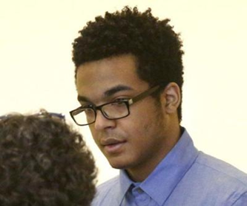
Doc: Brito thought he was a god
Brito’s charges cover a murder scene in Lynn, a double-shooting with no fatalities in Lawrence, and a sexual assault and armed robbery in North Andover that all took place within three days, from March 25 to 27, 2017. He pleaded not guilty by reason of insanity to all the charges, an admission of involvement but not responsibility, which requires prosecutors to prove that he was not suffering from a mental disease or disability at the time of the crimes and could have but chose not to act in accordance with the law.
The 10th day of the trial focused heavily on Brito’s use of cannabis, with prior testimony indicating that he had some level of cannabis dependence. Three new witnesses were also called, including a person Brito contacted by phone in an effort to buy 3.5 grams of marijuana the day of the fatal shooting in Lynn and convenience store crimes in North Andover.
…he realized he was using excessive amounts of marijuana and had psychotic experiences on marijuana.”
https://www.salemnews.com/news/doc-brito-thought-he-was-a-god/article_2f313050-03e5-11ee-a4bc-b73508c02465.html

Slide 56

Drug tests were not imposed on cannabis-smoking couple who went on to kill baby
Two magistrates ruled that a couple who smoked large amounts of cannabis and later went on to kill their baby were not required to undergo drug testing when he was returned to their care, it can be revealed.
Despite the pair having repeatedly lied to social workers about the amount of cannabis they consumed, the magistrates ordered that Shannon Marsden and Stephen Boden be given custody of the child.
The baby was found to have 71 bruises over his body and 57 fractures after he died on Christmas Day 2020 - just 39 days after Derby family court returned him to the couple's care.
https://www.msn.com/en-us/news/world/drug-tests-were-not-imposed-on-cannabis-smoking-couple-who-went-on-to-kill-baby/ar-AA1bBv1L?ocid=msedgntp&cvid=47588761ea1641b4ae650355f77ff7c5&ei=58

Slide 57
The Biggest Lie –
“No one ever dies from marijuana use”

Slide 58

Who is Stephanie Melgoza and what did she do? Illinois woman sentenced to 14 years in prison
STEPHANIE Melgoza will spend 14 years behind bars after pleading guilty to killing two pedestrians while drunk driving.
Andrea Rosewicz, 43, and Paul Prowant, 55, of Avon, Ohio, were tragically killed on April 10, 2022.
Police who attended the scene discovered a small bag of marijuana, a smoking pipe and an open bottle of vodka in her car.
https://www.the-sun.com/news/8014059/stephanie-melgoza-dui-andrea-rosewicz-bradley-illinois/

Slide 59


Edmonton man who killed seven-year-old girl found guilty of murder
"The evidence establishes that it is more likely than not that Mr. Moss's psychosis was not caused by the 2004 brain injury, but rather by cannabis-related causes — use, intoxication, withdrawal"
Cannabis use, not a brain injury, was the cause of the psychosis that gripped David Michael Moss’s mind when he brutally killed seven-year-old Bella Rose Desrosiers, a judge has ruled.
Court of King’s Bench Steven Mandziuk on Friday convicted Moss, 37, of second-degree murder for repeatedly slashing the girl’s throat as her mother tucked her into bed May 18, 2020.
Mandziuk rejected Moss’s claim he was not criminally responsible for Bella’s death due to a psychosis caused by a 2004 brain injury. Mandziuk found it more likely Moss’s marijuana use — which he abruptly halted while experiencing a spiritual “awakening” — was the cause of the psychosis.
https://edmontonjournal.com/news/local-news/edmonton-man-who-killed-7-year-old-girl-found-guilty-of-murder

Slide 60

Suspect in Macomb shooting appears in court
MACOMB (WGEM) - The man arrested Saturday following a house party shooting in Macomb Friday night made his first court appearance Monday.
Donell D. Williams, 23, of Macomb, appeared via Skype with a public defender before Judge Nigel Graham at 1:30 p.m. Monday.
Police arrested Williams and obtained a warrant to search his backpack where they found over a pound and a half of cannabis and a ghost gun.
Police reported that Jerman Beathea, 26, of Chicago was pronounced dead at the scene and ten other people were struck by gunfire and transported to McDonough District Hospital. Many of them were wounded with superficial gunshot wounds and were triaged then transported by ambulance to other area trauma units.
Police said six of the wounded were Western Illinois University students. Beathea was not a WIU student.
https://www.wgem.com/2023/03/27/suspect-macomb-shooting-appears-court/

Slide 61


S.F. prosecutors say deadly Sunset District explosion caused by dryer sparking vapors from in-home drug lab
Butane vapors from a home drug laboratory may have interacted with a dryer to cause a fiery eruption in San Francisco's Sunset District last week, prosecutors said in court Wednesday, revealing new details about a blast that killed a woman, severely burned another, and landed a 53-year-old man in jail facing multiple felonies.
Investigators say they found equipment used to manufacture hash oil in the rubble of the home. The illegal operation likely triggered the explosion.
https://www.msn.com/en-us/news/crime/s-f-prosecutors-say-deadly-sunset-district-explosion-caused-by-dryer-sparking-vapors-from-in-home-drug-lab/ar-AA17wXOa?ocid=msedgntp&cvid=ad9909b65b0a4340c8a182b5a258ea32

Slide 62

18 shots, no motive: Police release
timeline, findings in MSU shooting
EAST LANSING — Police said they found no conclusive motive for the man who shot eight people, three fatally, at Michigan State University Feb. 13.
Anthony McRae, 43, who killed himself hours after the shootings when confronted by police in north Lansing, had both alcohol and THC in his system
Police said McRae only used the Taurus handgun in the attack. Based on shell casings recovered, McRae fired at least 18 shots at Berkey Hall and the MSU Union.
https://www.lansingstatejournal.com/story/news/local/2023/04/27/michigan-state-mass-shooting-intoxicated-motive-timeline-map-anthony-mcrae/70157922007/

Slide 63
Black Lives Matter co-founder’s cousin dies after L.A. police blasted him with a Taser
Body camera video released by the LAPD showed officers responding to a traffic accident involving Keenan Darnell Anderson, a Black man who died at a hospital after he suffered a medical emergency about 4½ hours after his arrest.
At a news conference Wednesday, Police Chief Michel Moore said Anderson had committed a felony hit-and-run and tried to "get into another person's car without their permission."
A report by the police department's toxicology unit found that Anderson tested positive for cocaine metabolite and cannabinoids, Muñiz said. An independent toxicology test will be conducted by the Los Angeles County coroner's office. A cause of death has not been released.
https://www.nbcnews.com/news/us-news/bodycam-video-released-black-man-died-tased-los-angeles-police-rcna65524

Slide 64

Son Fatally Shot His Dad in the Head as He Was Sleeping: Police
A man shot his father in the back of the head as he was sleeping, Colorado police have said.
The Fremont County Sheriff's Office (FCSO) was alerted to reports of a person, later revealed to be suspect Joseph Tippet, 36, with a gun at the 400 block of South Reynolds, in Cañon City, on Friday, January 6.
The Cañon City Daily Record reported, citing authorities, that Tippet told them he shot his father while he slept and had consumed alcohol and marijuana that day, but that he had not felt their effects.
https://www.msn.com/en-us/news/crime/son-fatally-shot-his-dad-in-the-head-as-he-was-sleeping-police/ar-AA16dPLW?ocid=msedgntp&cvid=fae517cc58c146b2b3fe943fab9ffc21

Slide 65
16-year-old girl shot in the head after refusing to pick up marijuana bag, KY cops say
A 16-year-old girl was fatally shot in a Kentucky home over her refusal to pick up a bag of marijuana dropped on the floor, Kentucky cops say.
Scarlett Tucker was pronounced dead at the scene following the shooting, which took place on Tuesday, Jan. 3, at a home in Burlington, about 20 miles southwest of Cincinnati.
The Burlington Police Department said three other teenagers witnessed the shooting. Their statements led to the arrest of 18-year-old Demarkus Hedges.
https://www.yahoo.com/news/16-old-girl-shot-head-164015138.html

Slide 66
Oklahoma marijuana farm homicide: Authorities say all 4 victims ‘executed’ were Chinese nationals
The four people who were executed Sunday on an Oklahoma marijuana farm were Chinese citizens, state authorities confirmed Tuesday afternoon.
Three men and a woman – all Chinese nationals – were executed at about 5:45 p.m. on Sunday after a male suspect entered a building on a marijuana grow operation in Kingfisher County, Oklahoma, authorities said.
Law enforcement says they are not releasing the suspect's identity because it will put additional individuals in danger. The case is being investigated as a quadruple homicide.
https://www.msn.com/en-us/news/crime/oklahoma-marijuana-farm-homicide-authorities-say-all-4-victims-executed-were-chinese-nationals/ar-AA14qQff?ocid=msedgntp&cvid=7f7222a6d8fa4336b3f977b53d66c6fe

Slide 67
The Biggest Lie –
“No one ever dies from marijuana use”

Slide 68
Trucker was under influence of marijuana in fatal Toll Road crash, officials say
A crash on the Indiana Toll Road killed two people on Wednesday, June 1, 2022.
SOUTH BEND — A “horrific” crash in June when a semitrailer plowed into a line of slowing and stopped cars on the Indiana Toll Road has now resulted in criminal charges against the driver of the truck.
New York native Chasen Thompson, 27, is charged with seven felonies of causing death or serious injury while under the influence of marijuana in connection to the crash, which killed 45-year-old Eric Klein and 82-year-old Jacqueline Luczak.
https://www.yahoo.com/news/trucker-under-influence-marijuana-fatal-191051716.html

Slide 69

Coroner says Anne Heche wasn’t under influence of drugs or alcohol when she crashed
Anne Heche was not impaired by alcohol or any substance at the time of her death, according to a new report from the L.A. County medical examiner-coroner‘s office that was reviewed Tuesday by The Times.
Evidence of cannabinoids and benzodiazepine was found in a urine sample taken after she was admitted to the hospital, indicating that she had also used those drugs in recent days. No such evidence appeared in the blood sample. Fentanyl was also present in the urine sample, but that was consistent with the drug being administered in the hospital for pain. On Aug. 5, Heche drove erratically around Venice and Mar Vista before clipping a garage and then crashing her Mini Cooper into a home, which was destroyed in the fire that ensued. It took firefighters almost an hour to extract Heche from her car.
https://www.latimes.com/entertainment-arts/story/2022-12-06/anne-heche-cocaine-marijuana-toxicology

Slide 70

Chicago man found guilty of murder but mentally ill for intentionally crashing into car, killing McHenry man
William Bishop, 44, of Chicago, (pictured) was found guilty on multiple charges for causing a two-vehicle rollover crash that left one dead and another seriously hurt on Vanderkarr Road west of Kemman Road in Hebron on May 18, 2020
McHenry County Sheriff Sgt. Aimee Knop said at the time that an investigation indicated the Jeep, driven by Bishop, was traveling westbound on Vanderkarr Road. The Jeep crossed into the eastbound lane of traffic onto the eastbound shoulder where it struck the front of the eastbound Chevrolet.
The Northwest Herald, citing trial testimony and recorded police interviews, reported that Bishop was feeling paranoid, hearing voices and had smoke marijuana on the day of the crash.
https://www.lakemchenryscanner.com/2022/11/07/chicago-man-found-guilty-of-murder-but-mentally-ill-for-intentionally-crashing-into-car-killing-mchenry-man/

Slide 71

Virginia mom charged with murder after 4-
year-old son eats ‘large amount’ of THC
gummies
Dorothy Annette Clements, 30, is facing murder charges after her toddler ingested THC gummies.
A Virginia mom is facing murder charges in connection with the death of her 4-year-old son, police say.
Detectives from the department’s Child Victims Unit investigated the child’s death and learned from doctors that the child’s toxicity level showed a “high level” of tetrahydrocannabinol, or THC, the active chemical found in cannabis that produces a “high.”
Detectives determined that the child had ingested a “large amount” of THC gummies.
https://nypost.com/2022/10/20/virginia-mom-charged-with-murder-after-4-year-old-eats-thc-gummies/amp/

Slide 72
OSHA: Cultivation facility worker died after inhaling ground cannabis dust
OSHA fined Trulieve $35,219 for hazard communication violations. The cannabis company is contesting.
A marijuana cultivation facility worker who died in January could not breathe after inhaling ground cannabis dust at the Holyoke site, an Occupational Safety and Health Administration investigation found.
While filling pre-rolls at the Trulieve facility on Jan. 7, 27-year-old Lorna McMurrey said she couldn’t breathe, according to OSHA’s investigation summary, and later died at Baystate Medical Center in Springfield. OSHA determined that McMurrey died of occupational asthma
https://www.boston.com/news/local-news/2022/10/06/osha-trulieve-worker-asthma-death-cannabis/

Slide 73

High School Football Player Dies in Dad's Arms After NFL Star's Brother Allegedly Shoots Him
Police allege that Cook was there to purchase marijuana from Isaiah. However, there would be no exchange of cash. Instead, detectives allege Cook intended to steal the marijuana from Isaiah, and allegedly opened fire on the teen from inside his Jeep.
Police searched Cook's home, and allegedly recovered the gun used in the murder as well as the stolen marijuana
https://www.msn.com/en-us/news/crime/high-school-football-player-dies-in-dad-s-arms-after-nfl-star-s-brother-allegedly-shoots-him/ar-AA10lv52?ocid=msedgntp&cvid=9828ca237c6144af924866e34b0c960d

Slide 74

DUI Driver Who Killed Poway Father, Son to Be Sentenced
Donald Lee Farmer is facing four to eight years in prison following his guilty plea for two counts of gross vehicular manslaughter while intoxicated and one count of driving without a license. His plea stems from the Feb. 12, 2021 crash that killed 54-year-old Stephen Pirolli and his son, 14-year-old Stephen Pirolli Jr., according to prosecutors.
Sheriff's deputy Nathaniel Bier testified that the defendant was driving around 90 mph at the time of the crash even though the speed limit is 45 mph.
According to prosecutors, the then-19-year-old Farmer was under the influence of Xanax and marijuana at the time of the crash.
https://www.msn.com/en-us/news/crime/dui-driver-who-killed-poway-father-son-to-be-sentenced/ar-AAZKlyt?ocid=msedgntp&cvid=27128f2da0024080b17cf6d2b0f44e18#comments

Slide 75
Man killed in shooting at marijuana dispensary identified
Lloyd Wayne Cockrell, 55, of Bakersfield was identified by the Kern County Corner's Office. He was shot and killed Saturday on Stine Road near Pacheco Road, according to the department.
Officers were called to a marijuana dispensary in the 4800 block of Stine Road around 5:20 p.m. for a report of a shooting. When they arrived they found a man inside the business suffering from a gunshot wound. Emergency Medical aid was called but he died before they could take him to the hospital.
https://www.msn.com/en-us/news/crime/man-killed-in-shooting-at-marijuana-dispensary-identified/ar-AAZsRWj?ocid=msedgntp&cvid=3bd7936a430e44c0ada7a93f794ccbdb

Slide 76
Highland Park and why we need to talk about marijuana
Bobby Crimo III, the suspected mass shooter who gunned down seven people and injured dozens at the Independence Day parade in Highland Park, Illinois , was a stoner. Known in his local community as a rapper, Crimo wasn’t known for radical political beliefs. Instead, former collaborators who posted about him online in the aftermath of the shooting describe Crimo as a heavy marijuana user
https://www.washingtonexaminer.com/restoring-america/restoring-america/fairness-justice/highland-park-and-why-we-need-to-talk-about-marijuana

Slide 77
Woman had used marijuana and was impaired at time of 4-vehicle crash that left 2 dead, authorities say
A driver was charged with causing the deaths of two people after lab testing showed she was impaired after having used marijuana prior to the time of a four-vehicle Manchester crash earlier this year, the Ocean County Prosecutor’s Office announced Tuesday.
While at Community Medical Center, blood was drawn from Bowker after investigators received a court-authorized warrant, the office said. Lab results showed that Bowker had an active THC (marijuana) level of 7 nanograms (ng) with a metabolite THC level of 61ng – indicating that Bowker was a recent, active user of marijuana at the time of the crash.
https://www.nj.com/news/2022/06/woman-had-used-marijuana-and-was-impaired-at-time-of-4-vehicle-crash-that-left-2-dead-authorities-say.html

Slide 78
The Biggest Lie –
“No one ever dies from marijuana use”

Slide 79
Police: Driver in fatal Nebraska crash had used marijuana
One of the drivers in a crash that killed two women and injured 20 bystanders watching classic cars cruise down a Nebraska street tested positive for marijuana, police said.
He tested positive for drug use after the crash, but a breathalyzer test for alcohol use was negative.
The 18-year-old had not been ticketed as of Tuesday, but the crash report said he was driving over the 40 mph speed limit when he went through a yellow light on O Street in Lincoln before the crash
Police said that 20-year-old Emily Siebenhor and 22-year-old Edith Hermosillo died in the crash.
https://apnews.com/article/marijuana-nebraska-omaha-lincoln-0c8760f4844bd355ff708741fb046368

Slide 80
Uvalde Live Updates: Gunman Messaged Friend Before Shooting
The 18-year-old gunman messaged a friend that he had shot his grandmother and was planning to shoot up a school, the friend said. Nineteen children and two teachers were killed in a massacre that ripped open a nation’s deep divisions over gun violence.
When Jocelyn Rodriguez, 19, a Wendy’s employee, heard Mr. Ramos was the shooter, she was initially shocked, but soon his past behavior came into focus, she said. She knew him to have a bad temper and to snap at people. He had a tendency to pick fights with co-workers who were bigger than him, she said. And Ms. Rodriguez recalled he would often talk about how much he despised his mother and grandmother, whom he told her did not let him smoke weed or do what he wanted.
https://www.nytimes.com/live/2022/05/25/us/shooting-robb-elementary-uvalde

Slide 81
Woman, 23, dies and friend, 21, is taken to hospital after eating 'Cannabis sweets' they ordered on phone and had delivered to London home as police issue warning
A 23-year-old woman has died after eating cannabis sweets after having them delivered via a messaging app on her phone.
Both women were taken to an east London hospital, but sadly, the 23-year-old died four days later on Saturday 2 April.
The woman's identity is not being released at the moment and a post-mortem examination is to be arranged. Her friend has been discharged from hospital following treatment.
Leon Brown, 37, of Albert Road, South Norwood, south London, has been charged in connection with the death.
https://www.dailymail.co.uk/news/article-10685115/Woman-23-dies-friend-21-taken-hospital-eating-Cannabis-sweets.html

Slide 82
California wildfires: Man gets 24 years for setting blaze that killed condors
A US man who started a wildfire that killed 12 endangered California condors and seriously injured a firefighter has been sentenced to 24 years in prison.
Prosecutors say Ivan Gomez, 31, set the Big Sur Dolan fire in August 2020 while illegally cultivating cannabis in the Los Padres National Forest.
A fire captain was seriously injured and two others were also taken to hospital for burns and smoke inhalation.
He is said to have been shirtless, sweating and carrying several lighters that matched those found at the fire's point of origin. Gomez confessed to officers that he had an illegal cannabis grow in the forest and it had started the fire.
https://www.bbc.com/news/world-us-canada-61526895

Slide 83
Las Vegas teen dies after being struck while hanging from Jeep in suspected DUI case
A Las Vegas teenager died days after he was run over while riding a skateboard and hanging onto the passenger side of a Jeep last week, police say.
The 15-year-old was holding onto the side of a 2018 Jeep Wrangler that was heading west on Forsythe Drive, near Sloan Lane and Sahara Avenue, around 9 p.m. Friday, May 13, Las Vegas Metropolitan Police said.
At some point, the teen was thrown off the skateboard and run over by the Jeep.
The driver of the Jeep was identified as 19-year-old Destiny Jimenez. According to an arrest report, Jimenez told police she was drinking alcohol and smoking marijuana before the crash.
https://news3lv.com/news/local/las-vegas-teen-dies-after-being-struck-while-hanging-from-jeep-in-suspected-dui-case

Slide 84

NTSB: Teenage driver in deadly crash had cannabis in system
TISHOMINGO, Okla. (AP) — The teenage driver of a small car that collided with a large truck in Oklahoma, killing all six occupants in the car, tested negative for alcohol but positive for cannabis after her death, according to a preliminary report released Thursday.
According to the report, the teen driver turned left at a stop sign when her car was struck by an oncoming truck. The truck's driver was not injured and tested negative for alcohol and drugs, the NTSB report said.
The six girls who died ranged in age from 15 to 17.
https://www.msn.com/en-us/news/us/ntsb-teenage-driver-in-deadly-crash-had-cannabis-in-system/ar-AAWXuqB?ocid=msedgntp&cvid=883ac65fe6f54342b139b99b650923b2

Slide 85
Victim shot and killed at Tarzana marijuana dispensary
Los Angeles Police Department officers are looking for two suspects who opened fire at a business in Tarzana, killing at least one person.
After officers entered the business, they discovered a victim who suffered gunshot wounds.
LAPD told CBSLA Reporter Rick Montanez that the shooting took place at a medical marijuana dispensary.
Los Angeles Fire Department first responders pronounced the victim dead at the scene.
https://www.msn.com/en-us/news/crime/victim-shot-and-killed-at-tarzana-marijuana-dispensary/ar-AAWN2Pd?ocid=msedgntp&cvid=6446848214be49caa74a0087b0f3fabc

Slide 86
OAKLAND (KPIX 5) — An early Sunday morning burglary at an Oakland dispensary led to a shooting that injured a business owner. Cannabis merchants said this is the latest example of their industry under attack and it’s more dangerous to do business now than before marijuana was legal. Oakanna is a brand new dispensary on Lakeshore Avenue near Lake Merritt that opened a week ago on April 16.
Oakland cannabis merchants have been complaining about the robberies on top of the high taxes. Some have even threatened to leave town. Last November, Oakland police said burglars hit up cannabis stores about two dozen times.
https://sanfrancisco.cbslocal.com/2022/04/24/owner-of-new-oakland-cannabis-dispensary-shot-sunday-morning/

Slide 87
Suspect sought in Sacramento shooting
Police have asked for public’s help to find Mtula Payton, who they say was involved.
SACRAMENTO — Police have identified a man they believe is among those responsible for the shootout that killed six and wounded 12 in downtown Sacramento this month, officials said Tuesday, but they have exhausted “all leads” and need the public’s help to find him.
In a news release, Sacramento police named Mtula Payton — a 27-year-old with a long criminal record — as one of five alleged shooters who fired off more than 100 rounds in the early hours of April 3 in a gun battle that caught dozens of downtown patrons in the crossfire in the worst instance of gun violence in the United States this year.
Payton was also charged, over the years, with second-degree robbery, possessing marijuana for sale, stealing from Macy’s and driving without a license.
https://news.yahoo.com/police-seeking-another-suspect-sacramento-035711312.html

Slide 88

Colombia AG releases Taylor Hawkins' preliminary toxicology screening
Colombia's Attorney General's Office released a preliminary "forensic medical study" Saturday following the death of Foo Fighters' drummer Taylor Hawkins.
The report said a urine toxicology test was carried out on Hawkins and 10 substances were found, including THC, tricyclic antidepressants, benzodiazepines and opioids.
The band announced the news of Hawkins' death in a Friday statement, shortly before they were set to take the stage at a music festival in Bogotá.
The cause of death was not disclosed.
https://www.msn.com/en-us/news/us/colombia-ag-releases-taylor-hawkins-preliminary-toxicology-screening/ar-AAVxa86?ocid=msedgntp&cvid=6119090f78684b0e89514cee25e12666

